Slide 1
Interpretation of Latent Space in Deep-Learning Based Image Compression
Zengyu Yan
Zengyu.yan@epfl.ch

Slide 2
Tasks
Study the state of the art in deep-learning based image compression.
Get familiarized with the tools used for deep learning (PyTorch, Tensorflow, Google Colab)
Select most promising end-to-end implementations of deep-learning based image compression algorithms.
Analyze the performance of the selected end-to-end deep-learning based image compression algorithms (rate-distortion plots).
Study the state of the art of the latent space interpretation in deep learning.
*(Optional) Extract a latent space vector for one of the deep-learning based image codecs and explore the possibilities of meaningful modifications of such a vector that can cause an observable change in the reconstructed image.
Document all the development process and source code.

Slide 3
Tasks
Studied the state of the art in deep-learning based image compression
Selected the most promising end-to-end implementations of deep-learning based image compression algorithm
Dataset: Kodak, 24 images in total;
Compress the images using 4 models described in the paper;
Make a table of all the bits per pixel after compression;
Select the first 4 images and plot rate-distortion figure using matrices PSNR, SSIM, MSSSIM, VIFP.

Slide 4
Models
"High-Fidelity Generative Image Compression"
- hific-lo
- hific-mi
- hific-hi
"Joint Autoregressive and Hierarchical Priors for Learned Image Compression"
- mbt2018-mean-mse-[1-8]
- mbt2018-mean-msssim-[1-8]
"Variational Image Compression with a Scale Hyperprior"
- bmshj2018-factorized-mse-[1-8]
- bmshj2018-factorized-msssim-[1-8]
- bmshj2018-hyperprior-mse-[1-8]
- bmshj2018-hyperprior-msssim-[1-8]
"Efficient Nonlinear Transforms for Lossy Image Compression"
- b2018-leaky_relu-128-[1-4]
- b2018-leaky_relu-192-[1-4]
- b2018-gdn-128-[1-4]
- b2018-gdn-192-[1-4]

Slide 5
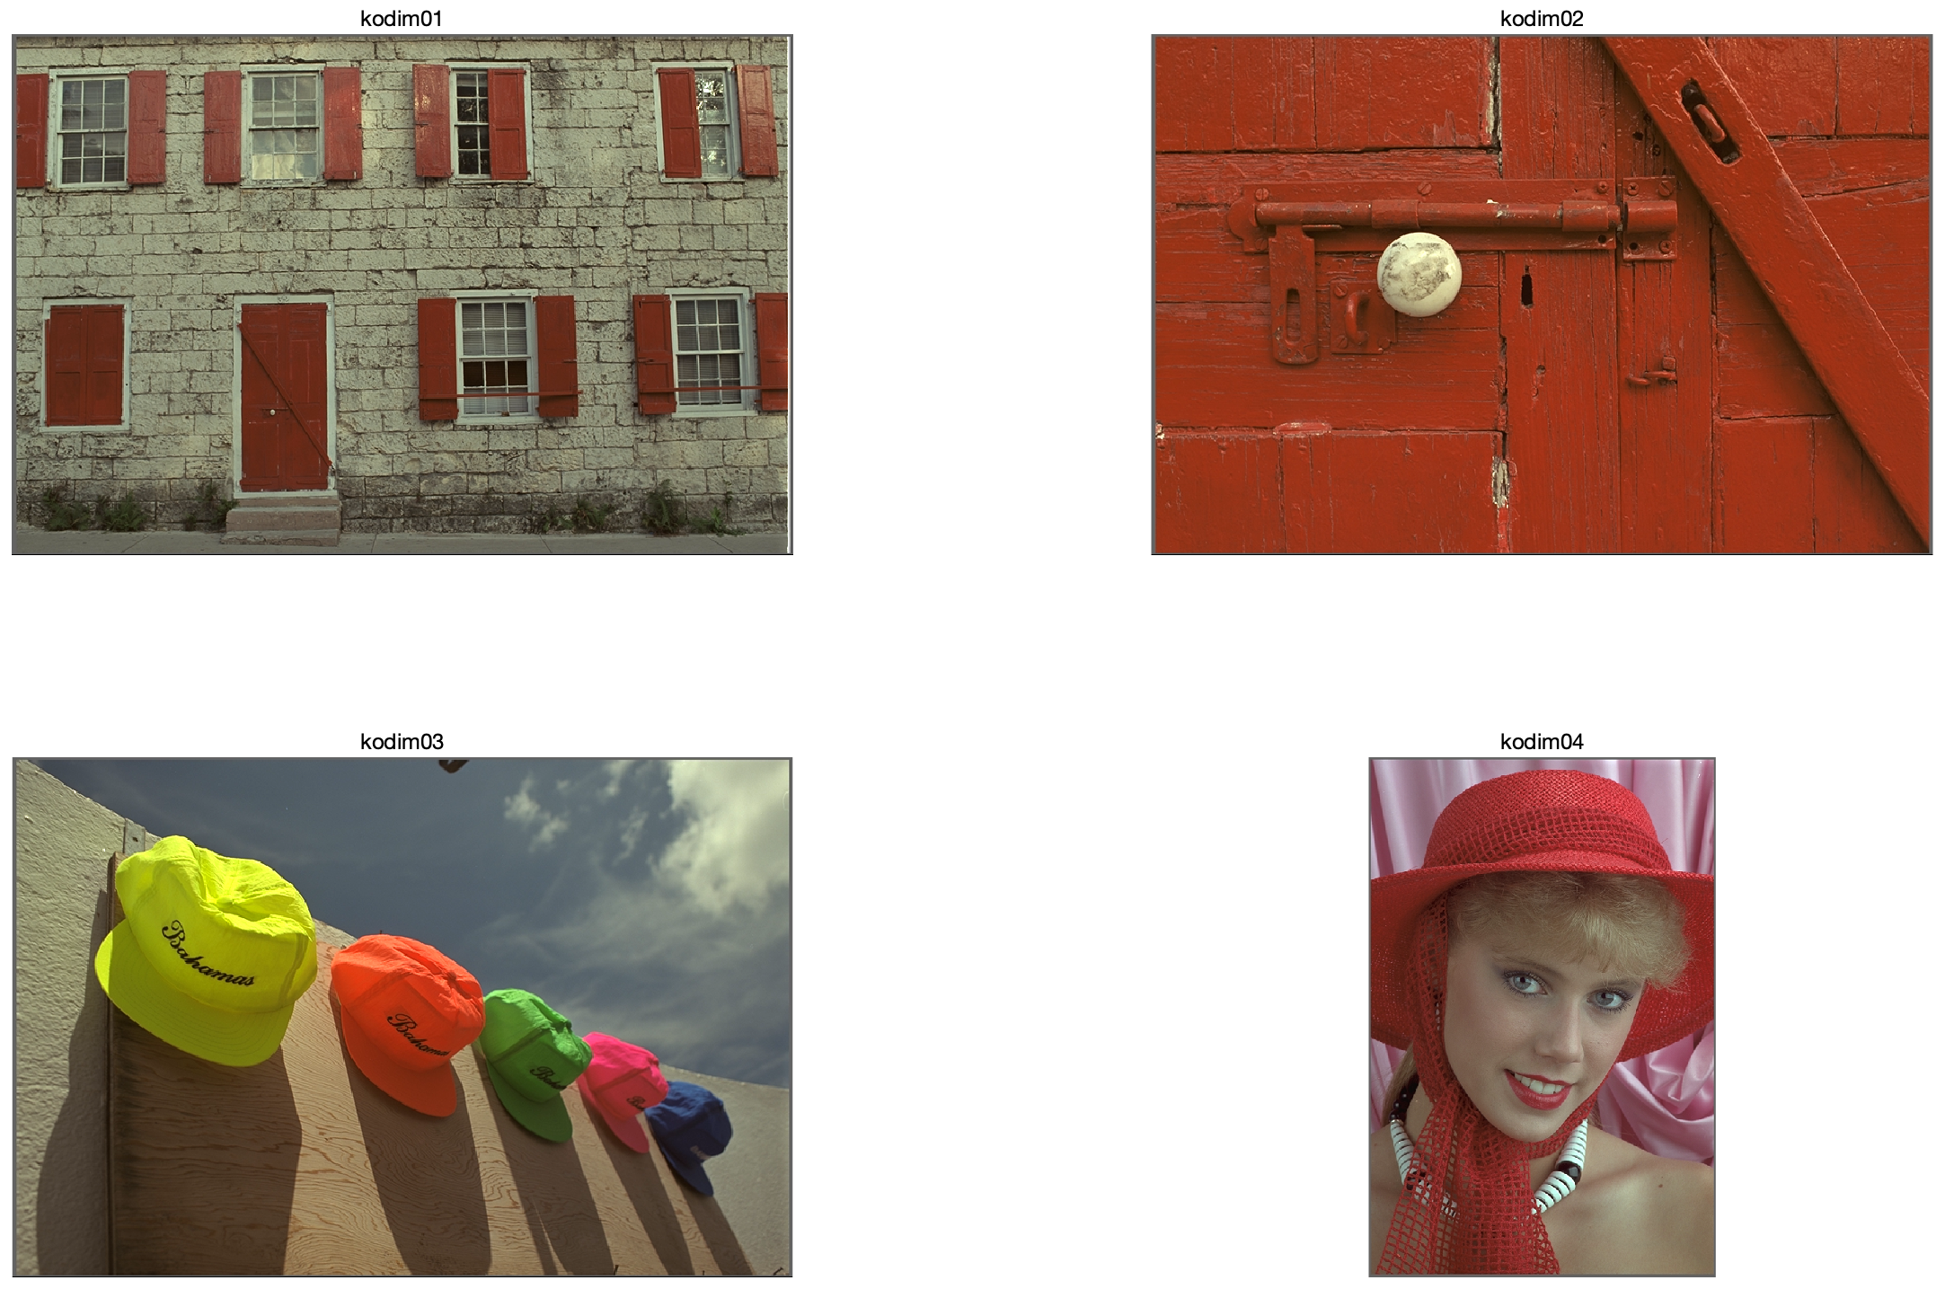
Original images

Slide 6
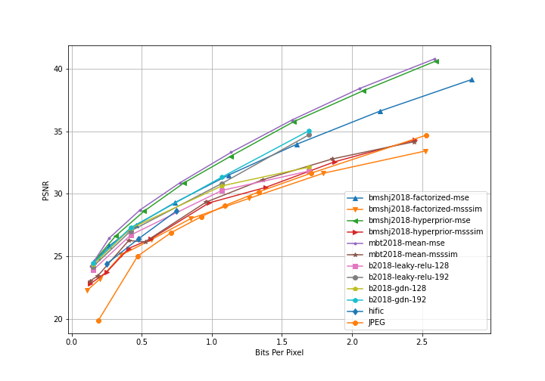
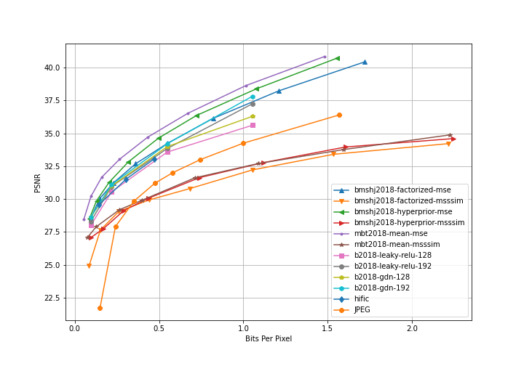
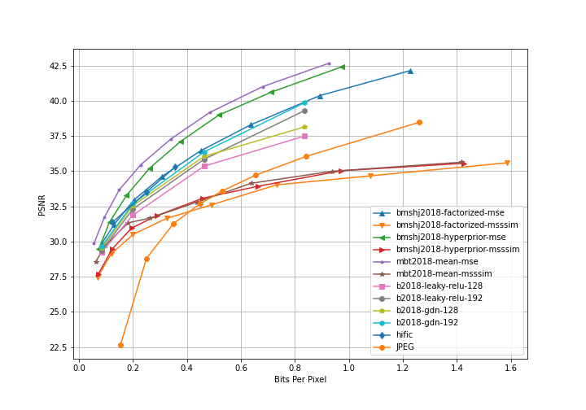
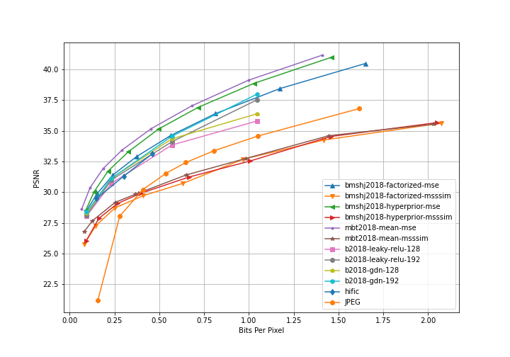
PSNR

Slide 7
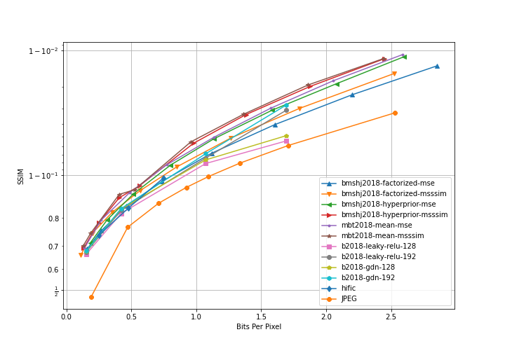
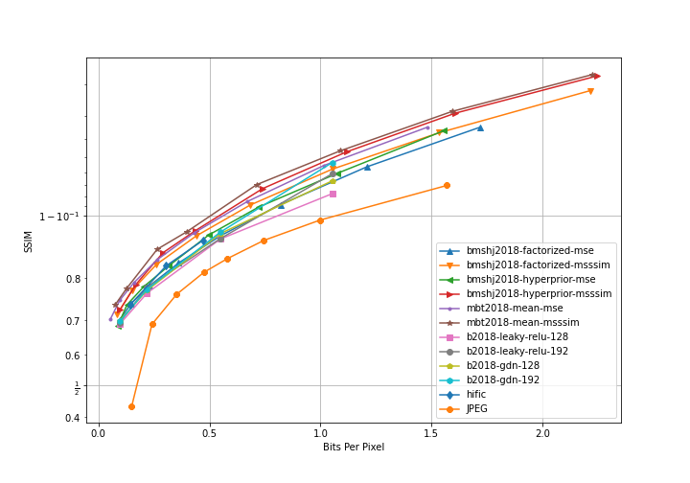
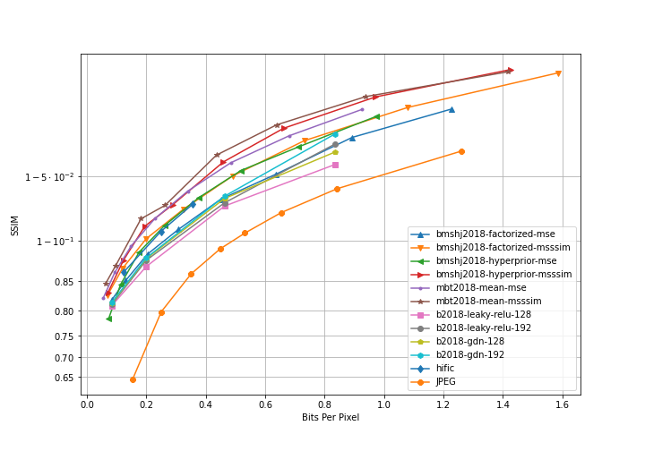
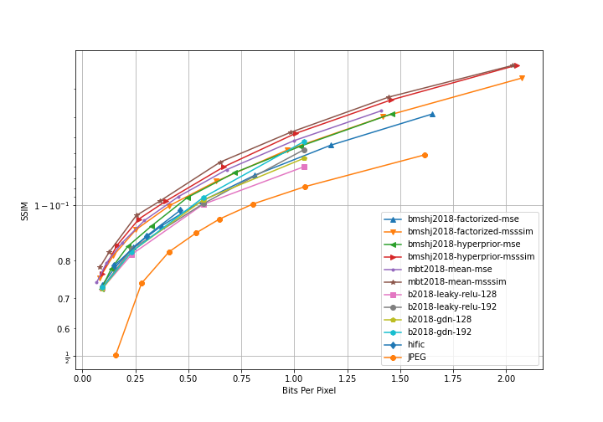
SSIM

Slide 8

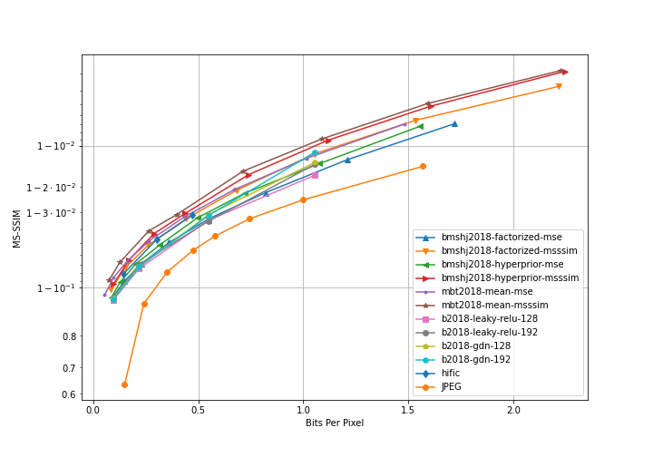
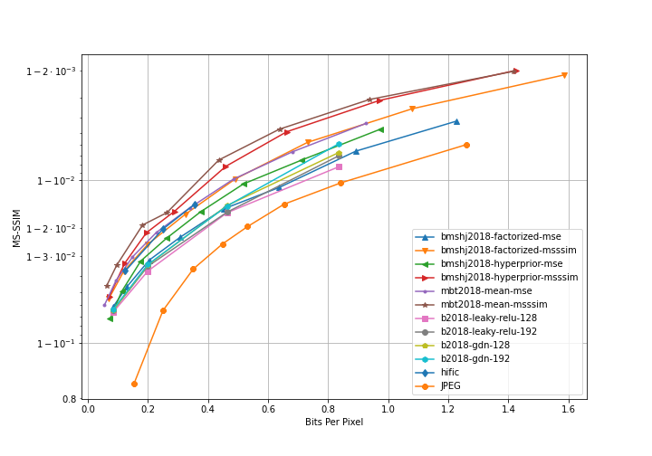
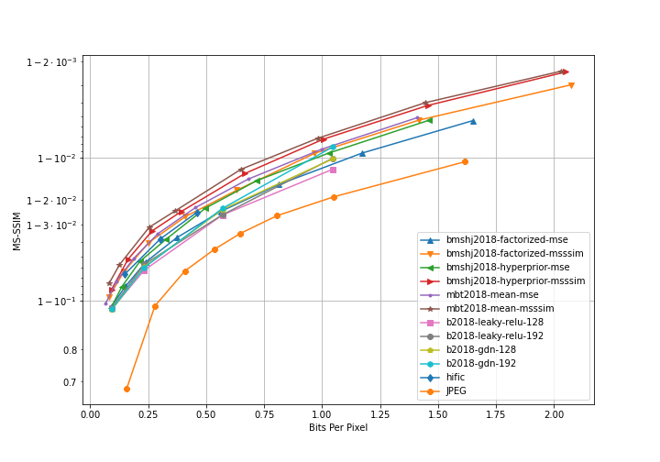
MSSSIM

Slide 9
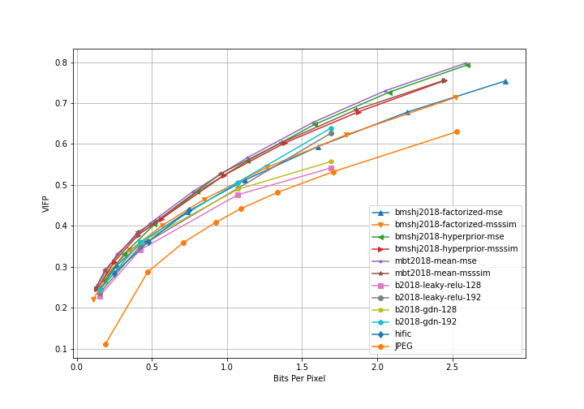
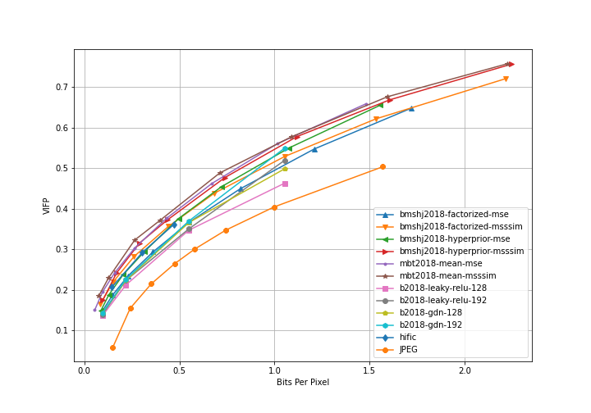
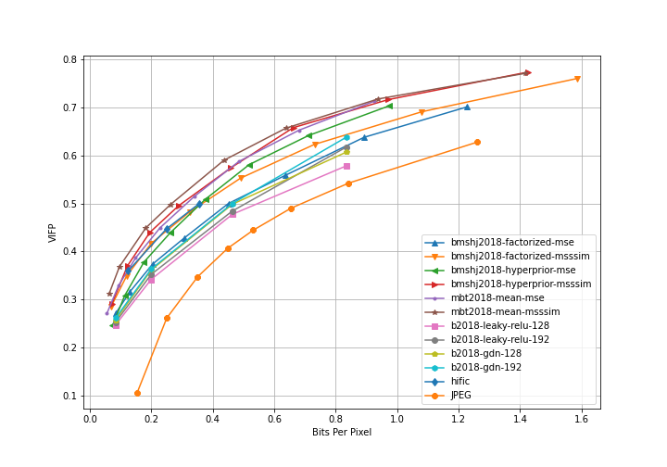
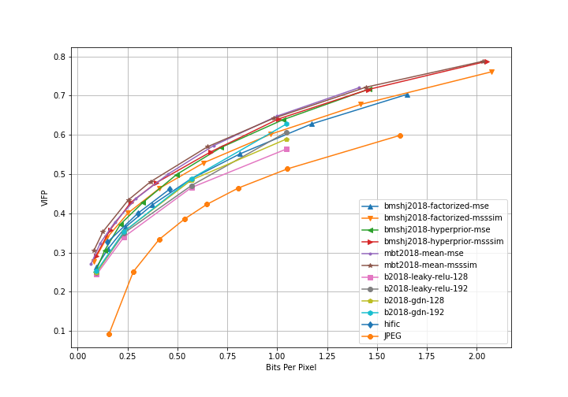
VIFP

Slide 10
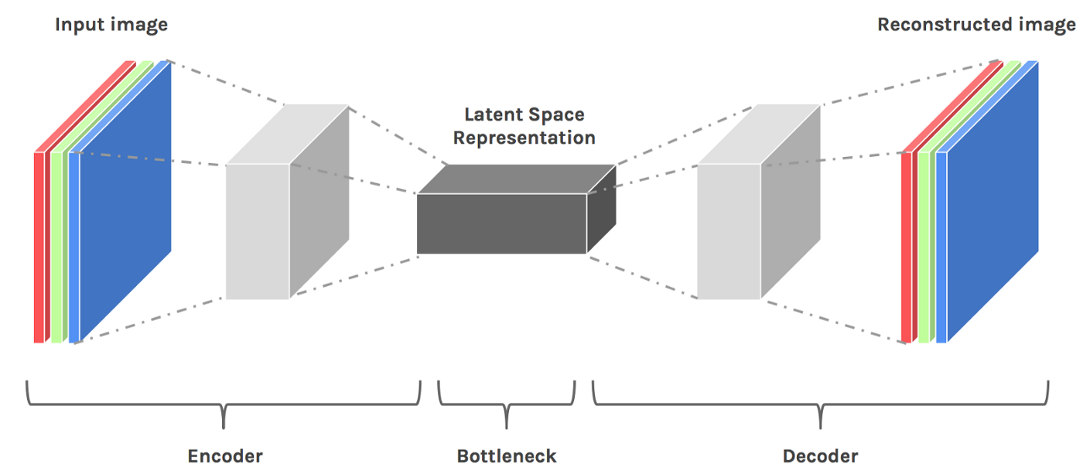
Latent space interpretation
Study the state of art of the latent space interpretation in deep learning

Slide 11
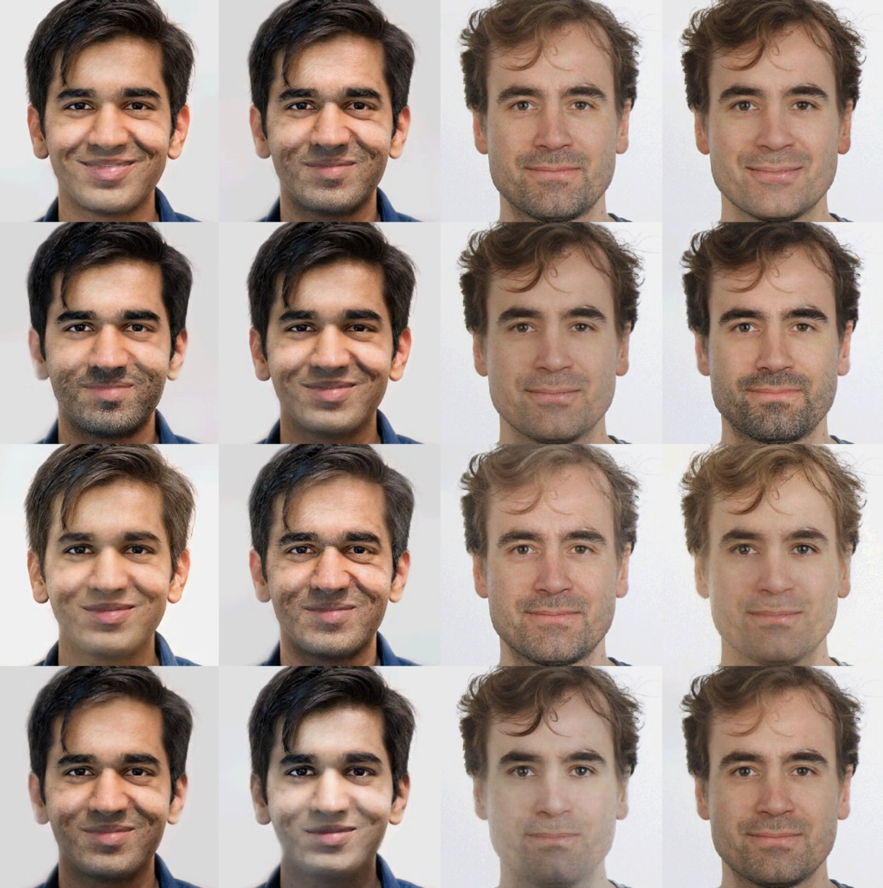
Latent space interpretation
So far, the latent space representation has been studied in generative adversarial networks (GAN), which aims at mapping points in the latent space to generated images.

Slide 12
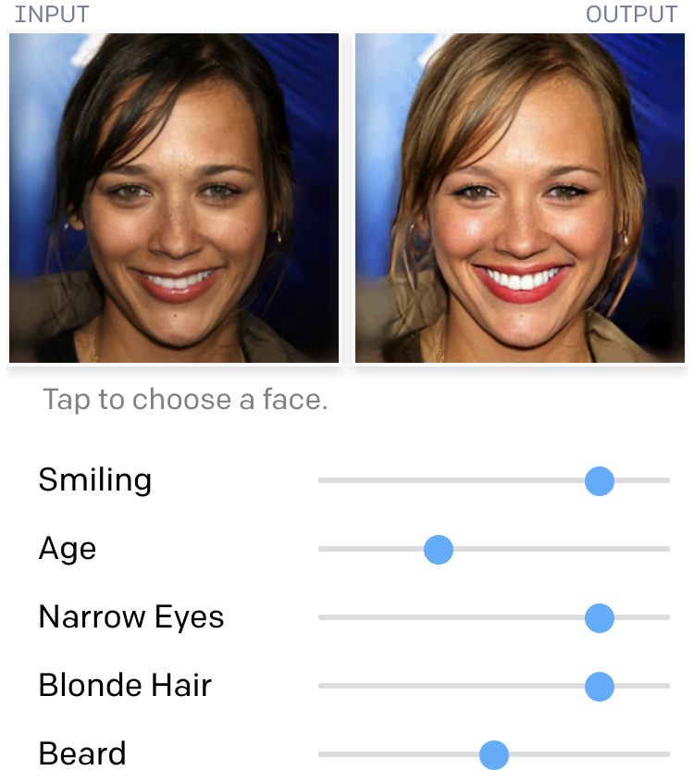
Latent space interpretation
https://openai.com/blog/glow/

Slide 13
Latent space Extraction
*(Optional) Extract a latent space vector for one of the deep-learning based image codecs and explore the possibilities of meaningful modifications of such a vector that can cause an observable change in the reconstructed image.
The model being selected: ‘bmshj2018-hyperprior-mse’ from "Variational Image Compression with a Scale Hyperprior”
Test image: ” stmalo_fracape.png” from internet

Slide 14
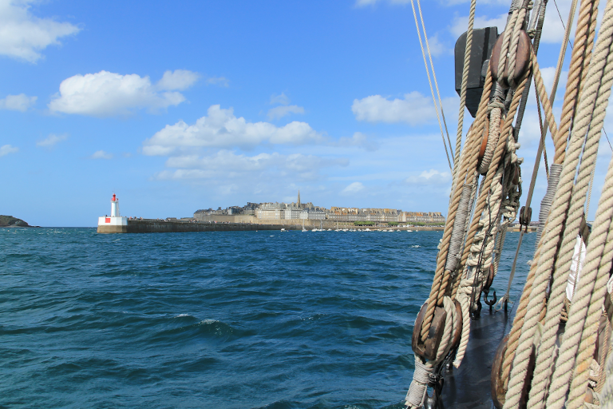
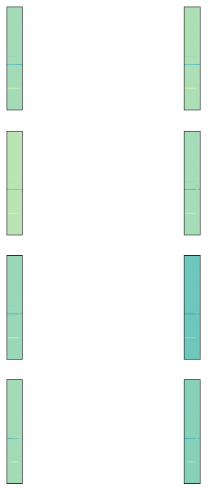
Latent space Extraction
Test image-original
Latent size: [192, 32, 48]
Laten space visualization (part)

Slide 15
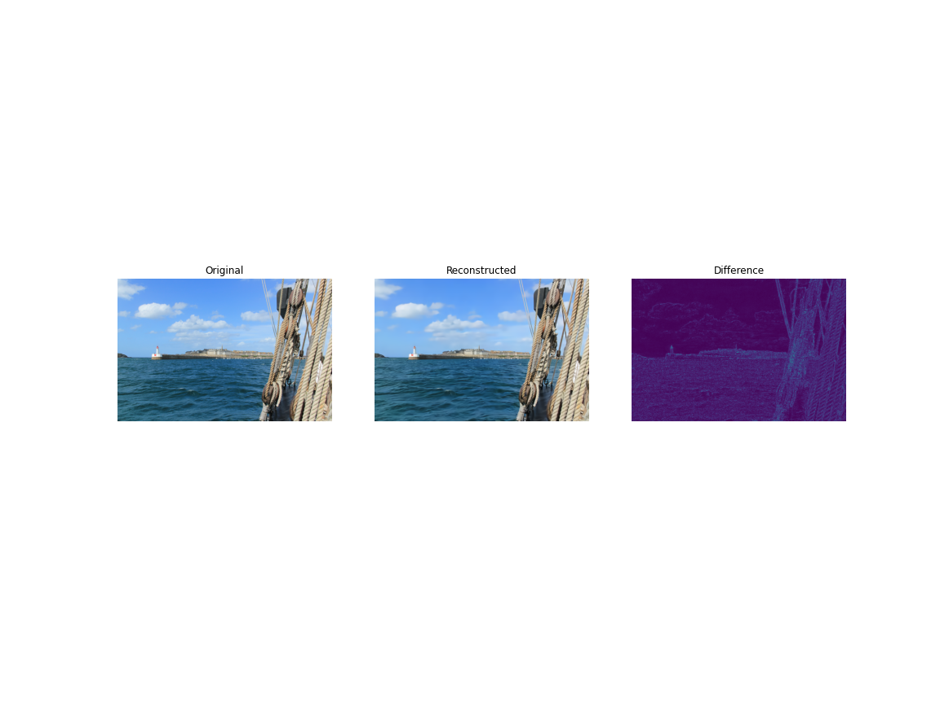
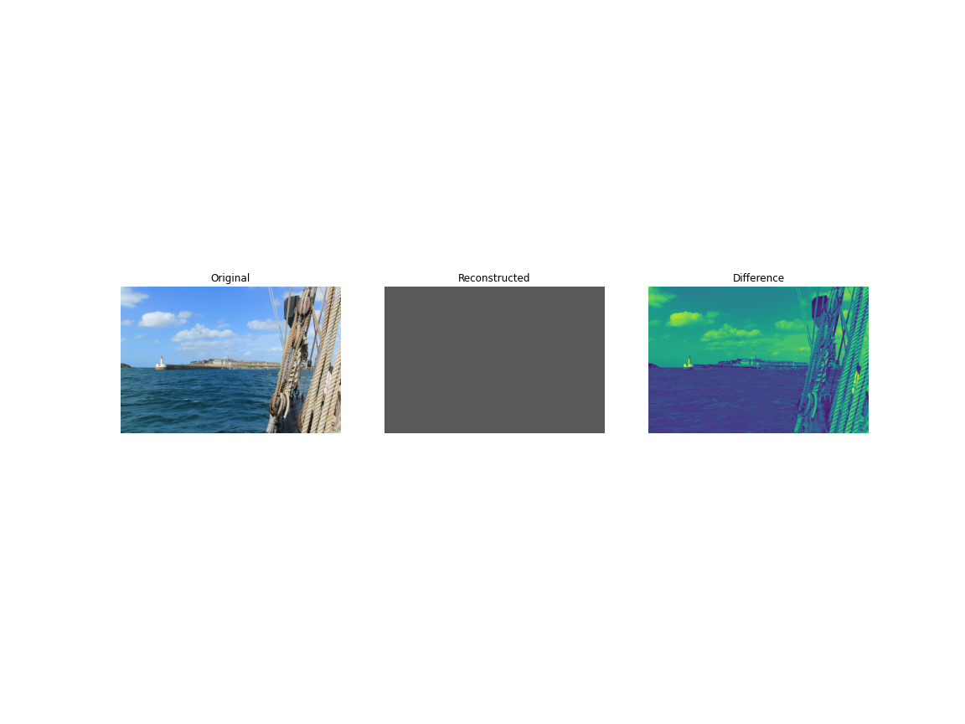
Latent space Extraction
original model:
PSNR: 31.42dB MS-SSIM: 0.9803 Bit-rate: 0.498 bpp
set all latent variables to zero:
PSNR: 9.75dB MS-SSIM: 0.3690 Bit-rate: 0.018 bpp

Slide 16
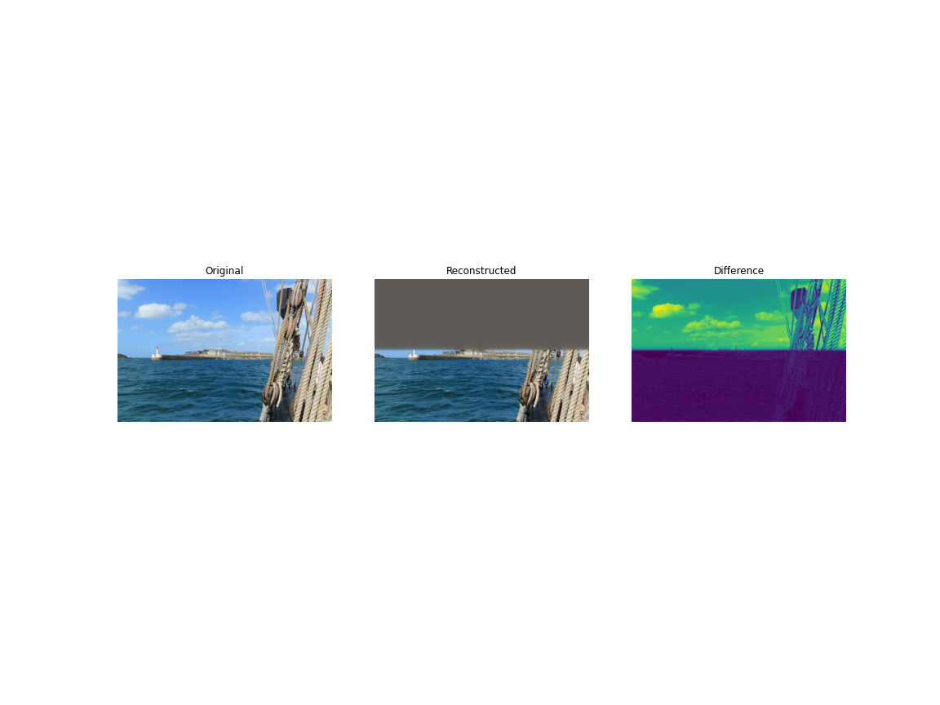
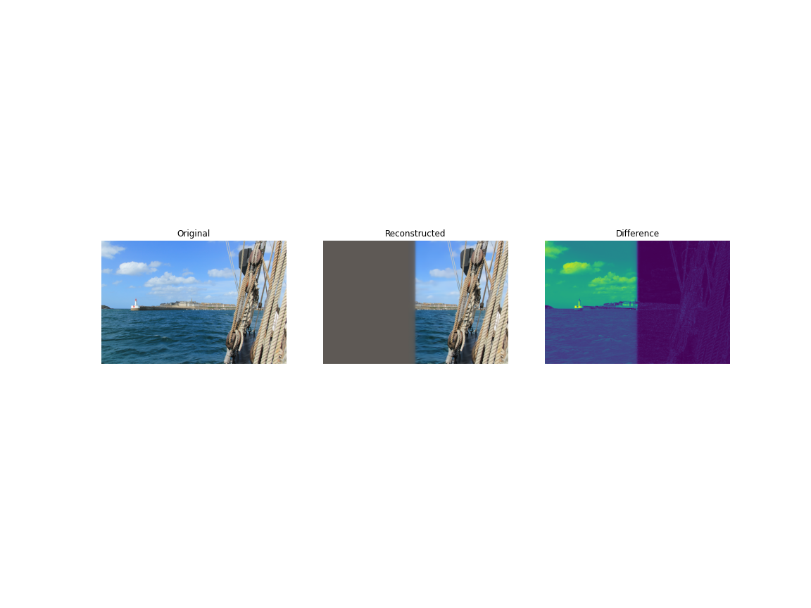
Latent space Extraction
set latent[:,0:16,:] to zero
PSNR: 11.02dB MS-SSIM: 0.7024 Bit-rate: 0.342 bpp
set latent[:,:,0:24] to zero
PSNR: 12.83dB MS-SSIM: 0.7145 Bit-rate: 0.366 bpp

Slide 17
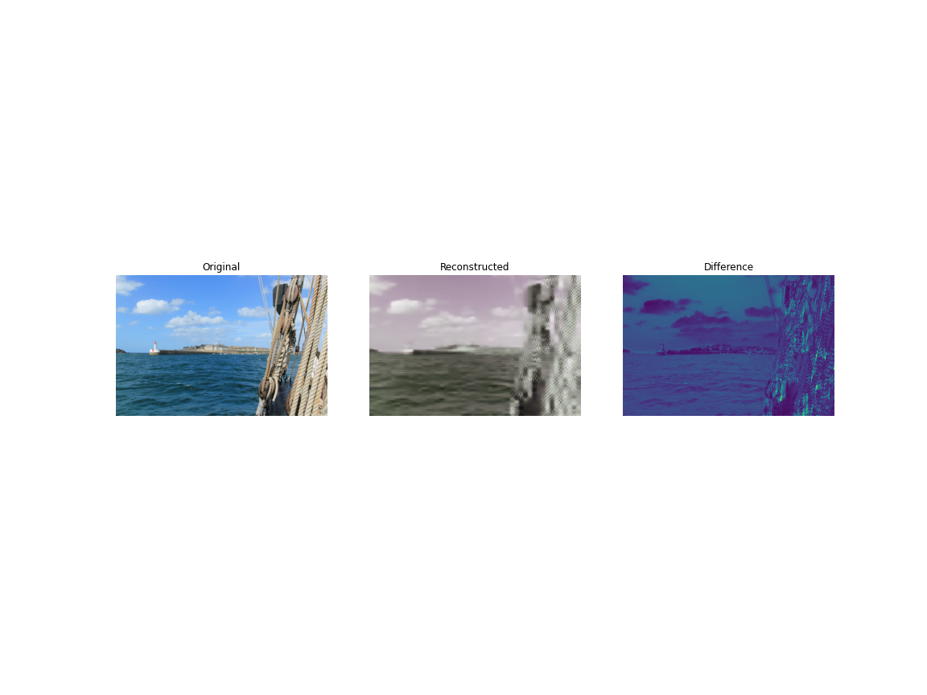
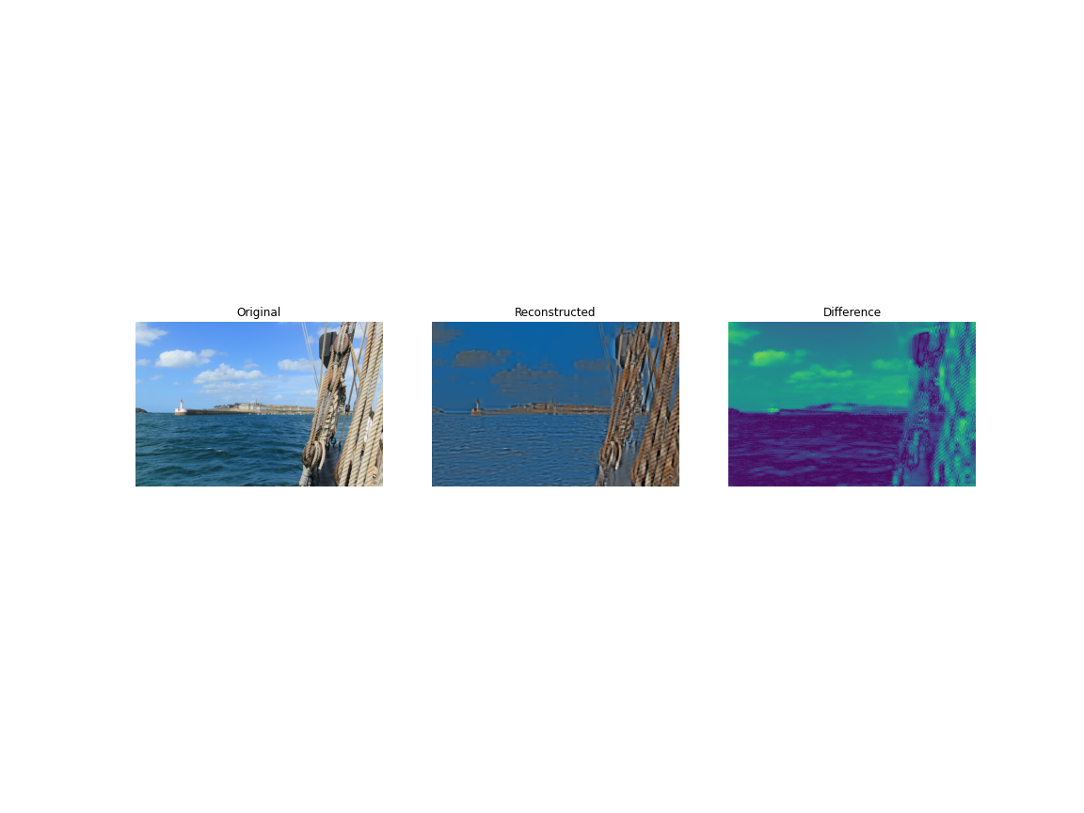
Latent space Extraction
set latent[0:96,:,:] to zero
PSNR: 15.89dB MS-SSIM: 0.7301 Bit-rate: 0.414 bpp
set latent[96:192,:,:] to zero
PSNR: 10.99dB MS-SSIM: 0.6327 Bit-rate: 0.419 bpp

Slide 18
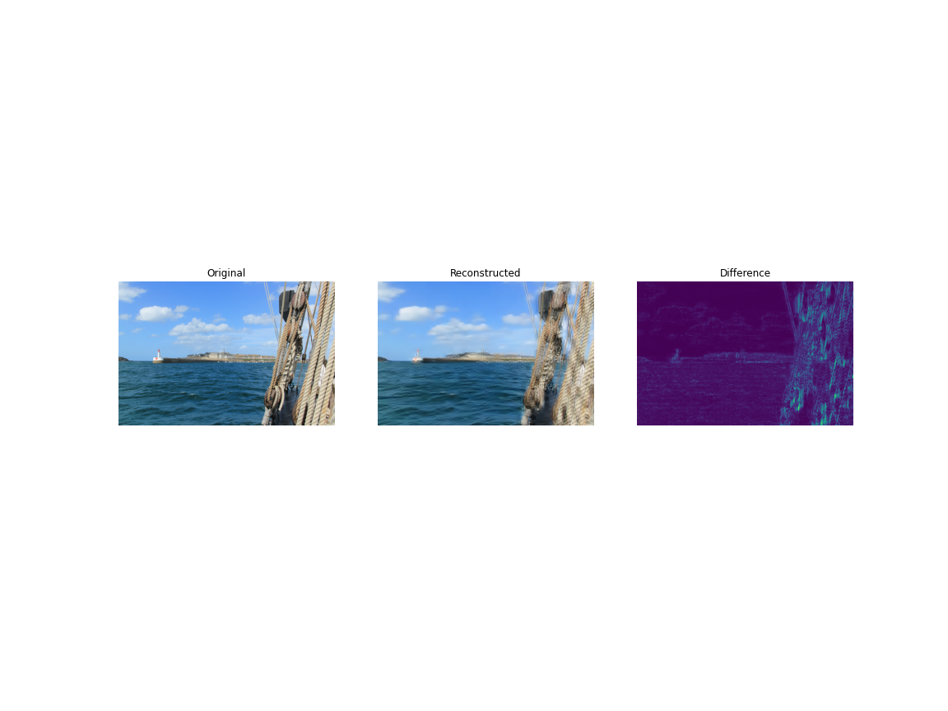
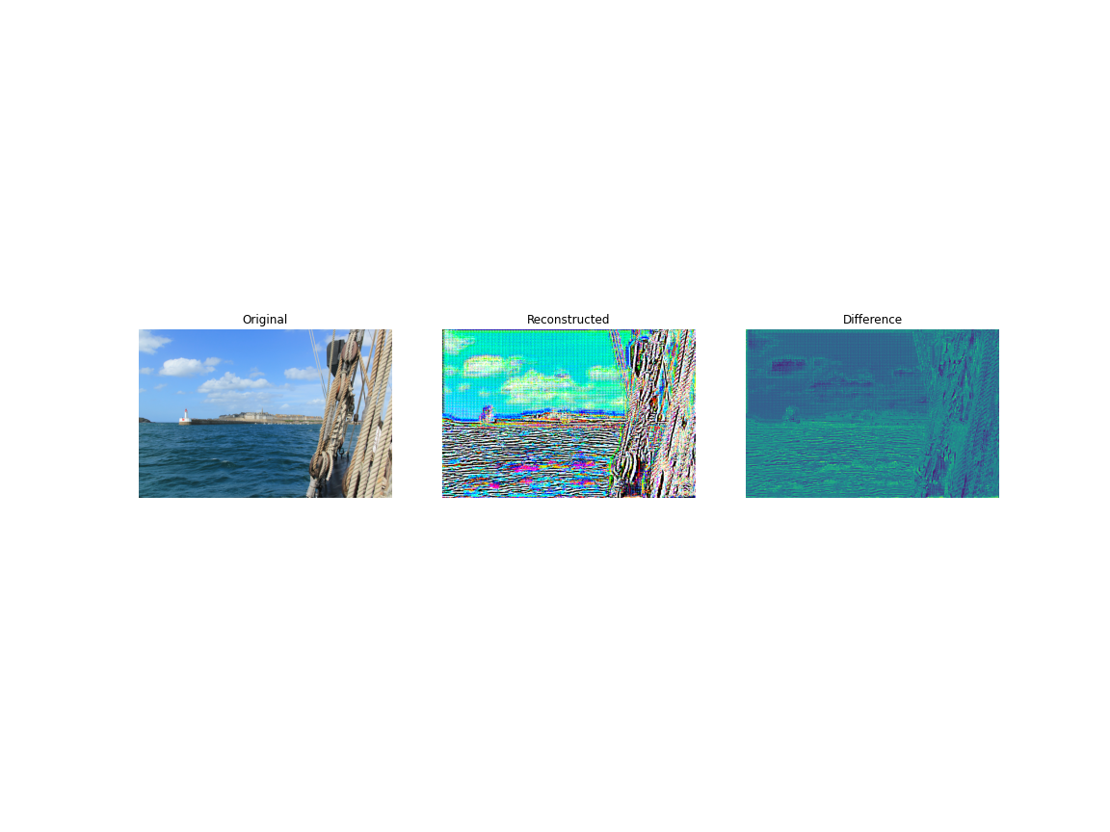
set latent[64:128,:,:] to zero
PSNR: 23.17dB MS-SSIM: 0.8827 Bit-rate: 0.449 bpp
multiply latent by a factor of 100
PSNR: 6.61dB MS-SSIM: 0.2760 Bit-rate: 5.231 bpp

Slide 19
Conclusion
In this project, we studied the state-of-art learning-based image compression technique, and analyzed their performance by conducting experiment and plotting rate-distortion plots. In addition, we also extract a latent space vector from one specific learning-based algorithm and change it to see the resulting image. Unlike image generation that based on generative models, where each vector can represent a certain feature, in image compression the algorithm however takes the input image as a whole and compress it. Modifications on the latent space result in output images that differ hugely from the original implementation, regardless of visual perception or objective assessment metric. Future work can be conducted by using different transformations or algorithms to explore meaningful changes in the latent space.

Slide 20

Thank you!
Zengyu Yan
Zengyu.yan@epfl.ch
Multimedia Signal
Processing Group
EPFL
http://mmspg.epfl.ch/

